Slide 1
Gradient-based optimization

Slide 2
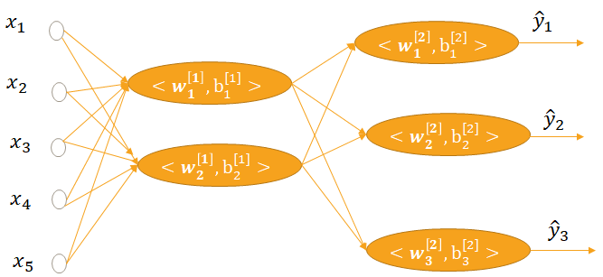
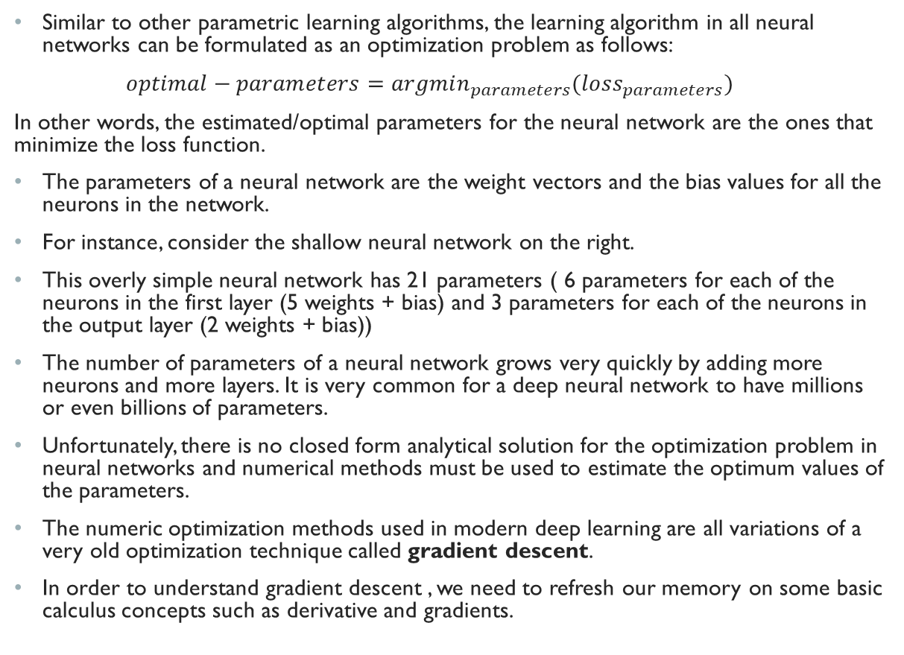
Estimating the parameters of a neural network
Similar to other parametric learning algorithms, the learning algorithm in all neural networks can be formulated as an optimization problem as follows:
$optimal−parameters=argmin_{parameters}(loss_{parameters})$
In other words, the estimated/optimal parameters for the neural network are the ones that minimize the loss function.
The parameters of a neural network are the weight vectors and the bias values for all the neurons in the network.
For instance, consider the shallow neural network on the right.
This overly simple neural network has 21 parameters ( 6 parameters for each of the neurons in the first layer (5 weights + bias) and 3 parameters for each of the neurons in the output layer (2 weights + bias))
The number of parameters of a neural network grows very quickly by adding more neurons and more layers. It is very common for a deep neural network to have millions or even billions of parameters.
Unfortunately, there is no closed form analytical solution for the optimization problem in neural networks and numerical methods must be used to estimate the optimum values of the parameters.
The numeric optimization methods used in modern deep learning are all variations of a very old optimization technique called gradient descent.
In order to understand gradient descent , we need to refresh our memory on some basic calculus concepts such as derivative and gradients.

Slide 3
Differential calculus
Differential calculus is fundamentally the study of how functions behave under small changes to their parameters
This is very important for deep learning because, given the sheer number of parameters in neural network, the loss function in deep learning is extraordinarily complex, making it impossible to exhaustively search the space of all parameters to find the optimal values.
In practice, we often start by initializing the parameters (weights and biases) randomly and then iteratively take small steps in the direction which makes the loss function decrease as rapidly as possible.
The question is then , at each point, how do we find the direction which makes the loss function decrease as quickly as possible?
To answer this question, we need to understand the concept of gradient. We first start with single variable differentiation and then multivariable differentiation

Slide 4
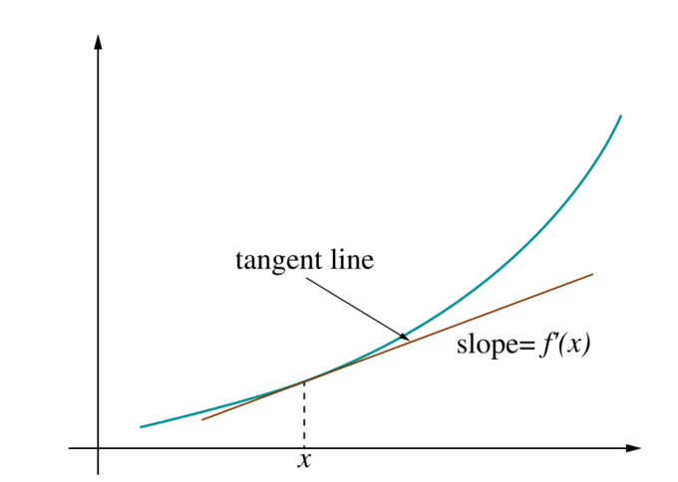
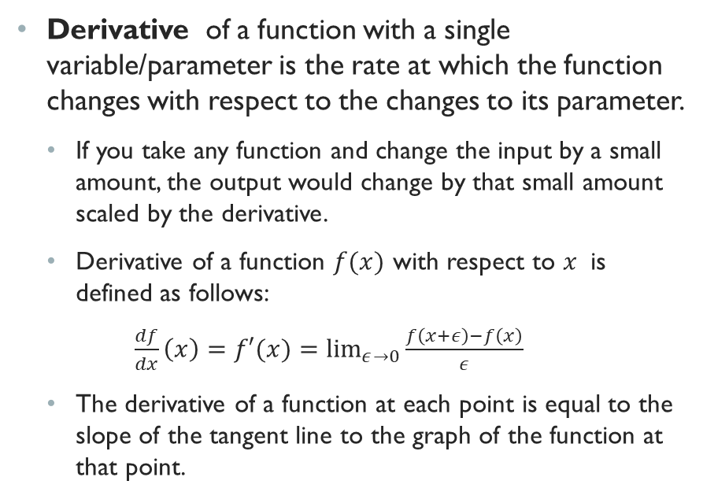
Derivative
Derivative of a function with a single variable/parameter is the rate at which the function changes with respect to the changes to its parameter.
If you take any function and change the input by a small amount, the output would change by that small amount scaled by the derivative.
Derivative of a function $f(x)$ with respect to $x$ is defined as follows:
$\frac{df}{dx}\left(x\right)=f′(x)=\lim_{ε→0}{\frac{f\left(x+ε\right)−f\left(x\right)}{ε}}$
The derivative of a function at each point is equal to the slope of the tangent line to the graph of the function at that point.

Slide 5

Common derivatives
Derivative of the several common functions can be derived from the definition in the previous slide:
Derivative of a constant:
$\frac{dC}{dx}=0$
Derivative of linear function
$\frac{d\left(ax\right)}{dx}=a$
Power rule:
$\frac{dx^{n}}{dx}=nx^{n−1}$
Derivative of exponential
$\frac{de^{x}}{dx}=e^{x}$
Derivative of the logarithm
$\frac{dlog\left(x\right)}{dx}=\frac{1}{x}$

Slide 6
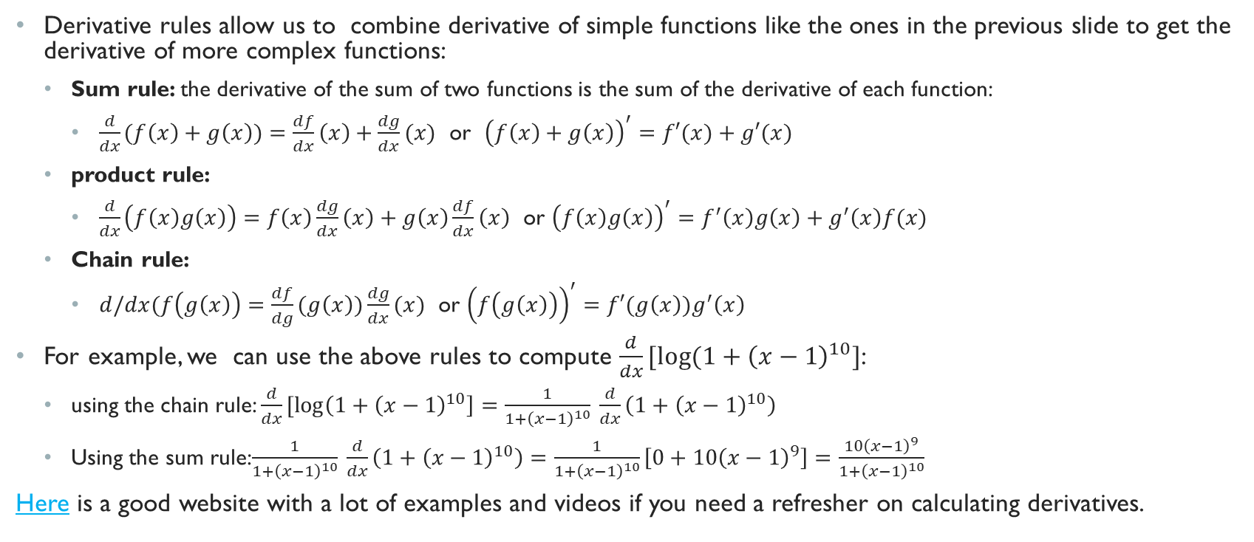
Derivative Rules
Derivative rules allow us to combine derivative of simple functions like the ones in the previous slide to get the derivative of more complex functions:
Sum rule: the derivative of the sum of two functions is the sum of the derivative of each function:
$\frac{d}{dx}(f\left(x\right)+g\left(x\right))=\frac{df}{dx}\left(x\right)+\frac{dg}{dx}(x)$ or ${\left(f\left(x\right)+g\left(x\right)\right)}^{′}=f′(x)+g′(x)$
product rule:
$\frac{d}{dx}\left(f\left(x\right)g\left(x\right)\right)=f\left(x\right)\frac{dg}{dx}\left(x\right)+g\left(x\right)\frac{df}{dx}\left(x\right)$ or ${\left(f\left(x\right)g\left(x\right)\right)}^{′}=f^{′}\left(x\right)g\left(x\right)+g^{′}\left(x\right)f(x)$
Chain rule:
$d/dx(f\left(g\left(x\right)\right)=\frac{df}{dg}(g\left(x\right))\frac{dg}{dx}(x)$ or ${\left(f\left(g\left(x\right)\right)\right)}^{′}=f′(g\left(x\right))g^{′}\left(x\right)$
For example, we can use the above rules to compute $\frac{d}{dx}[log⁡(1+{\left(x−1\right)}^{10}]$:
using the chain rule: $\frac{d}{dx}[\log\left(1+{\left(x−1\right)}^{10}\right]=\frac{1}{1+{\left(x−1\right)}^{10}} \frac{d}{dx}\left(1+{\left(x−1\right)}^{10}\right)$
Using the sum rule:$\frac{1}{1+{\left(x−1\right)}^{10}} \frac{d}{dx}\left(1+{\left(x−1\right)}^{10}\right)=\frac{1}{1+{\left(x−1\right)}^{10}}\left[0+10{\left(x−1\right)}^{9}\right]=\frac{10{\left(x−1\right)}^{9}}{1+{\left(x−1\right)}^{10}}$
Here is a good website with a lot of examples and videos if you need a refresher on calculating derivatives.

Slide 7
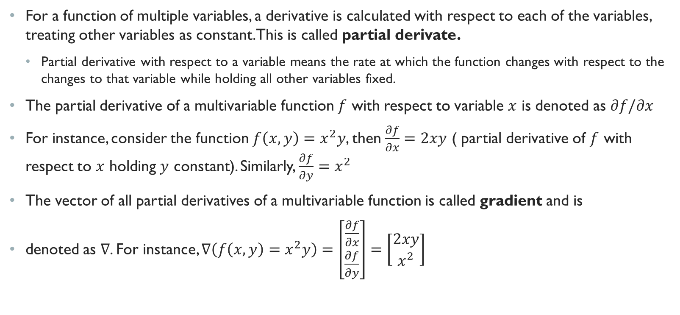
Multi-variable differentiation
For a function of multiple variables, a derivative is calculated with respect to each of the variables, treating other variables as constant. This is called partial derivate.
Partial derivative with respect to a variable means the rate at which the function changes with respect to the changes to that variable while holding all other variables fixed.
The partial derivative of a multivariable function $f$ with respect to variable $x$ is denoted as $∂f/∂x$
For instance, consider the function $f\left(x,y\right)=x^{2}y$, then $\frac{∂f}{∂x}=2xy$ ( partial derivative of $f$ with respect to $x$ holding $y$ constant). Similarly, $\frac{∂f}{∂y}=x^{2}$
The vector of all partial derivatives of a multivariable function is called gradient and is
denoted as $∇$. For instance, $∇\left(f\left(x,y\right)=x^{2}y\right)=\left[\begin{matrix}\frac{∂f}{∂x} \\ \frac{∂f}{∂y}\end{matrix}\right]=\left[\begin{matrix}2xy \\ x^{2}\end{matrix}\right]$

Slide 8
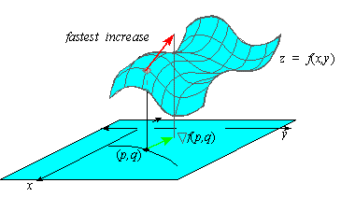
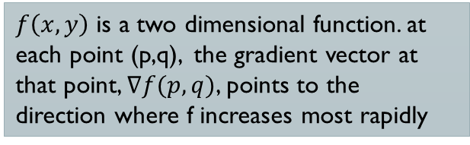
Gradient: the direction of steepest ascent
The gradient vector has an important property and that is, the gradient vector of a function always points to the direction of steepest ascent ( that is, the direction of maximum increase in the function).
Proof of this is out of the scope of this lecture but if you are interested to know why, you can refer to this video from khan academy. Here is another good read
Analogously, the negative of the gradient would be the direction of the greatest descent, that is the direction of maximum decrease in the function.
This property is the basis of gradient descent, an old optimization technique forming the backbone of the learning algorithm in all deep learning models.
$f\left(x,y\right)$ is a two dimensional function. at each point (p,q), the gradient vector at that point, $∇f(p,q)$, points to the direction where f increases most rapidly

Slide 9
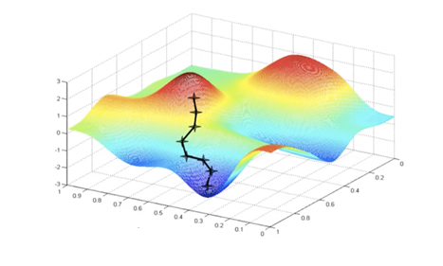
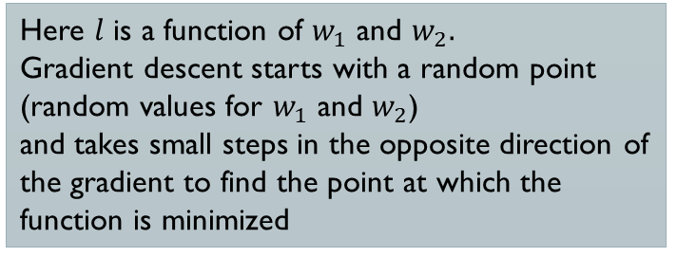



Gradient Descent Optimization
The gradient descent optimization algorithm is based on this simple idea. To find the point at which a function is minimized we can do the following steps:
start at a random point
Compute the gradient of the function
Take a small step towards the negative gradient.
4. Repeat the above steps until you reach a certain number of iteration or taking a small step towards the gradient does not change the value of the function
$$l(w_{1},w_{2})$$
$$w_{2}$$
$$w_{1}$$
Here $l$ is a function of $w_{1}$ and $w_{2}.$
Gradient descent starts with a random point (random values for $w_{1}$ and $w_{2}$)
and takes small steps in the opposite direction of the gradient to find the point at which the function is minimized

Slide 10

Gradient Descent Intuition
Imagine you’re blind folded in a rough terrain, and your objective is to reach the lowest altitude
One of the simplest strategies you can use, is to feel the ground in every direction, and take a step in the direction where the ground is descending the fastest
If you keep repeating this process, you might end up at the lake, or even better, somewhere in the huge valley.
The rough terrain is analogous to the loss function
Minimizing the loss function is analogous to trying to reach lower altitudes
You are blind folded, since we don’t have the luxury of evaluating (seeing) the value of the function for every possible set of parameters
Feeling the slope of the terrain around you is analogous to calculating the gradient, and taking a step is analogous to one iteration of update to the parameters.
Image source: KDnugget

Slide 11
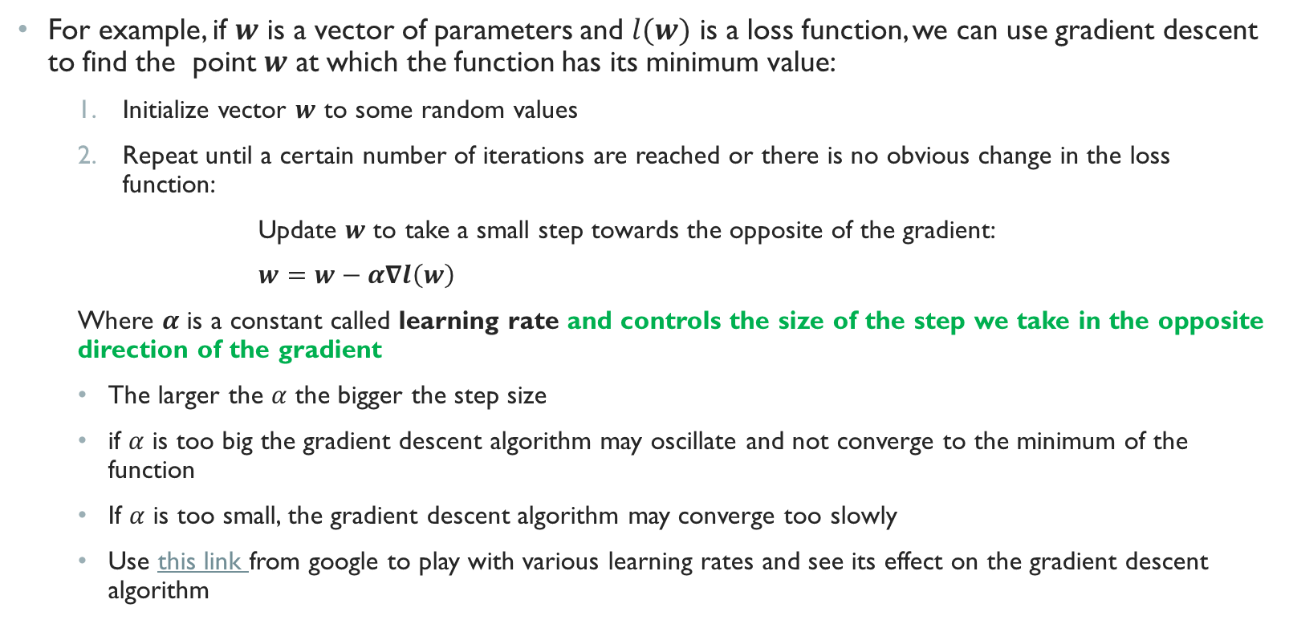
Gradient Descent Optimization (Cont.)
For example, if $w$ is a vector of parameters and $l(w)$ is a loss function, we can use gradient descent to find the point $w$ at which the function has its minimum value:
Initialize vector $w$ to some random values
Repeat until a certain number of iterations are reached or there is no obvious change in the loss function:
Update $w$ to take a small step towards the opposite of the gradient:
$w=w−α∇l\left(w\right)$
Where $α$ is a constant called learning rate and controls the size of the step we take in the opposite direction of the gradient
The larger the $α$ the bigger the step size
if $α$ is too big the gradient descent algorithm may oscillate and not converge to the minimum of the function
If $α$ is too small, the gradient descent algorithm may converge too slowly
Use this link from google to play with various learning rates and see its effect on the gradient descent algorithm

Slide 12

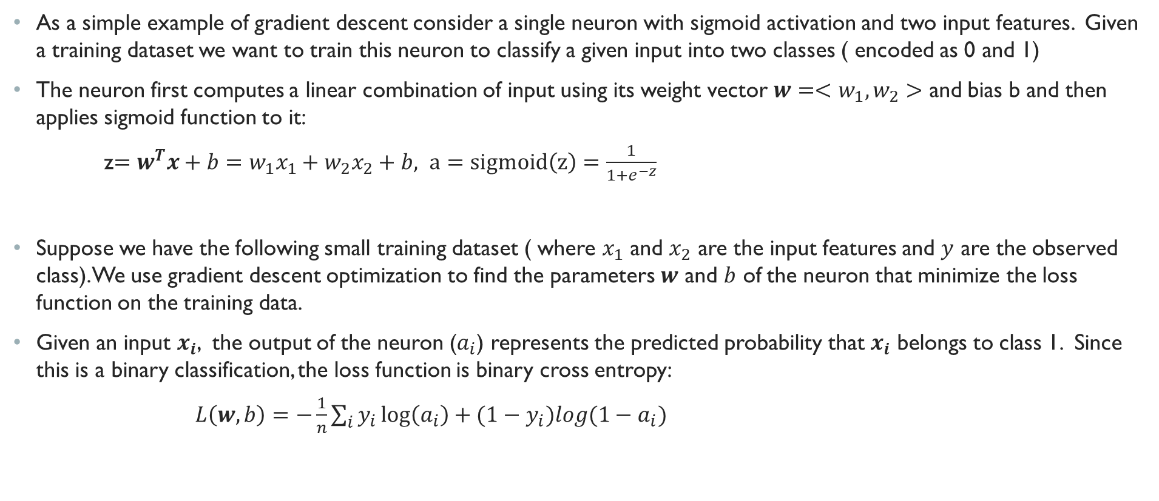
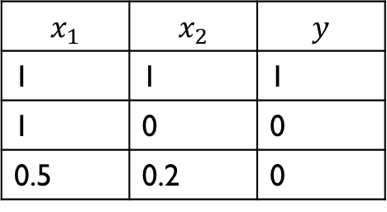


Gradient descent example
As a simple example of gradient descent consider a single neuron with sigmoid activation and two input features. Given a training dataset we want to train this neuron to classify a given input into two classes ( encoded as 0 and 1)
The neuron first computes a linear combination of input using its weight vector $w=<w_{1},w_{2}>$ and bias b and then applies sigmoid function to it:
z$=w^{T}x+b=w_{1}x_{1}+w_{2}x_{2}+b, a=sigmoid\left(z\right)=\frac{1}{1+e^{−z}}$
Suppose we have the following small training dataset ( where $x_{1}$ and $x_{2}$ are the input features and $y$ are the observed class). We use gradient descent optimization to find the parameters $w$ and $b$ of the neuron that minimize the loss function on the training data.
Given an input $x_{i}$, the output of the neuron ($a_{i}$) represents the predicted probability that $x_{i}$ belongs to class 1. Since this is a binary classification, the loss function is binary cross entropy:
$L\left(w,b\right)=−\frac{1}{n}\sum_{i}{y_{i}\log\left(a_{i}\right)+{(1−y}_{i})log(1−a_{i})}$
$$x=<x_{1},x_{2}>$$
$<w$,b>
$$a$$
$$x_{1}$$ | $$x_{2}$$ | $$y$$
1 | 1 | 1
1 | 0 | 0
0.5 | 0.2 | 0

Slide 13
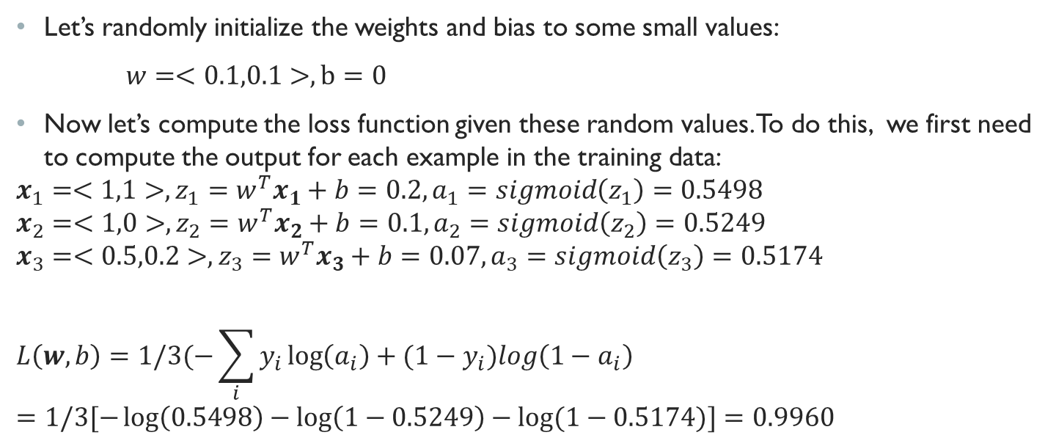
Gradient descent example: random initialization
Let’s randomly initialize the weights and bias to some small values:
$w=<0.1,0.1>, b=0$
Now let’s compute the loss function given these random values. To do this, we first need to compute the output for each example in the training data:
$$x_{1}=<1,1>, z_{1}=w^{T}x_{1}+b=0.2, a_{1}=sigmoid\left(z_{1}\right)=0.5498$$
$$x_{2}=<1,0>, z_{2}=w^{T}x_{2}+b=0.1, a_{2}=sigmoid\left(z_{2}\right)=0.5249$$
$$x_{3}=<0.5,0.2>, z_{3}=w^{T}x_{3}+b=0.07, a_{3}=sigmoid\left(z_{3}\right)=0.5174$$
$$L\left(w,b\right)=1/3(−\sum_{i}{y_{i}\log\left(a_{i}\right)+{(1−y}_{i})log\left(1−a_{i}\right)}=1/3[−\log\left(0.5498\right)−\log\left(1−0.5249\right)−log⁡(1−0.5174)]=0.9960$$

Slide 14
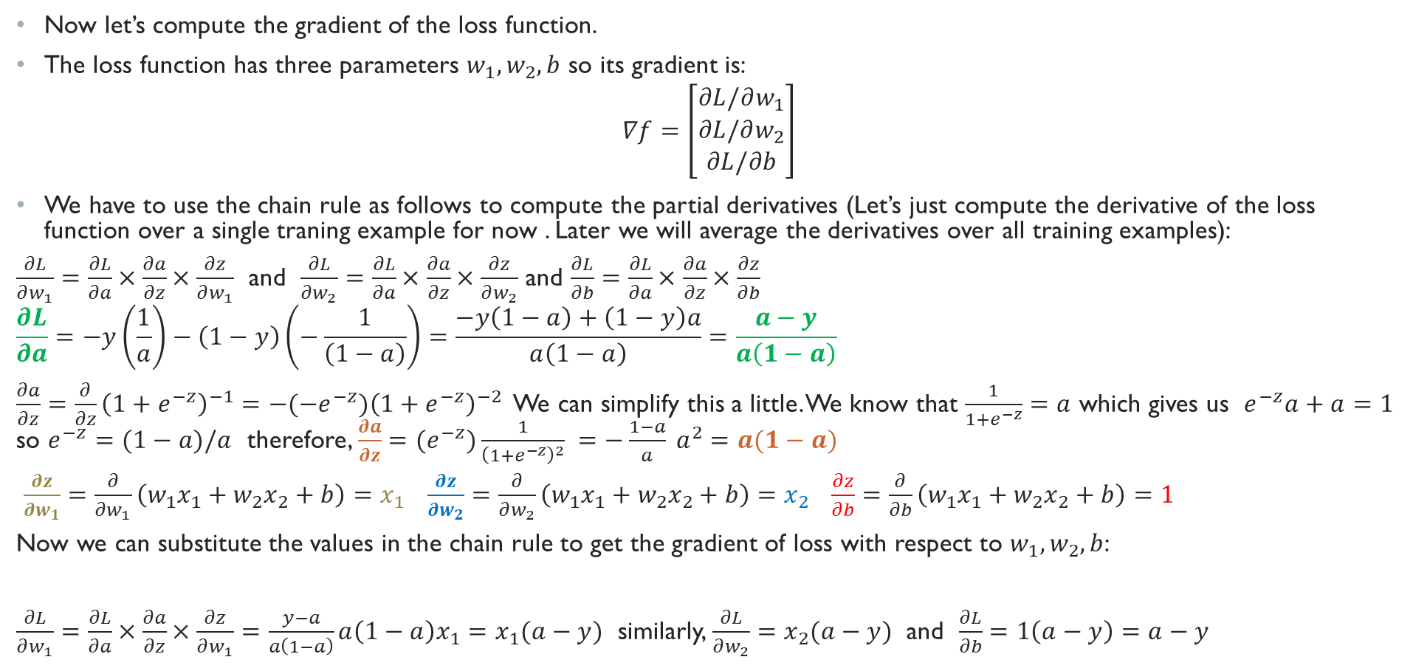
Gradient Descent Example: Computing the gradients
Now let’s compute the gradient of the loss function.
The loss function has three parameters $w_{1},w_{2},b$ so its gradient is:
$$∇f=\left[\begin{matrix}∂L/∂w_{1} \\ ∂L/∂w_{2} \\ ∂L/∂b\end{matrix}\right]$$
We have to use the chain rule as follows to compute the partial derivatives (Let’s just compute the derivative of the loss function over a single traning example for now . Later we will average the derivatives over all training examples):
$\frac{∂L}{∂w_{1}}=\frac{∂L}{∂a}×\frac{∂a}{∂z}×\frac{∂z}{∂w_{1}}$ and $\frac{∂L}{∂w_{2}}=\frac{∂L}{∂a}×\frac{∂a}{∂z}×\frac{∂z}{∂w_{2}}$ and $\frac{∂L}{∂b}=\frac{∂L}{∂a}×\frac{∂a}{∂z}×\frac{∂z}{∂b}$
$$\frac{∂L}{∂a}=−y\left(\frac{1}{a}\right)−\left(1−y\right)\left(−\frac{1}{\left(1−a\right)}\right)=\frac{−y\left(1−a\right)+\left(1−y\right)a}{a\left(1−a\right)}=\frac{a−y}{a\left(1−a\right)}$$
$\frac{∂a}{∂z}={\frac{∂}{∂z}\left(1+e^{−z}\right)}^{−1}=−(−e^{−z}{)\left(1+e^{−z}\right)}^{−2}$ We can simplify this a little. We know that $\frac{1}{1+e^{−z}}=a$ which gives us $e^{−z}a+a=1$ so $e^{−z}=(1−a)/a$ therefore, $\frac{∂a}{∂z}=(e^{−z})\frac{1}{{\left(1+e^{−z}\right)}^{2}} =−\frac{1−a}{a} a^{2}=a(1−a)$
$\frac{∂z}{∂w_{1}}=\frac{∂}{∂w_{1}}\left(w_{1}x_{1}+w_{2}x_{2}+b\right)=x_{1}$ $\frac{∂z}{∂w_{2}}=\frac{∂}{∂w_{2}}\left(w_{1}x_{1}+w_{2}x_{2}+b\right)=x_{2}$ $\frac{∂z}{∂b}=\frac{∂}{∂b}\left(w_{1}x_{1}+w_{2}x_{2}+b\right)=1$
Now we can substitute the values in the chain rule to get the gradient of loss with respect to $w_{1},w_{2},b$:
$\frac{∂L}{∂w_{1}}=\frac{∂L}{∂a}×\frac{∂a}{∂z}×\frac{∂z}{∂w_{1}}=\frac{y−a}{a\left(1−a\right)}a\left(1−a\right)x_{1}=x_{1}(a−y)$ similarly, $\frac{∂L}{∂w_{2}}=x_{2}(a−y)$ and $\frac{∂L}{∂b}=1\left(a−y\right)=a−y$

Slide 15
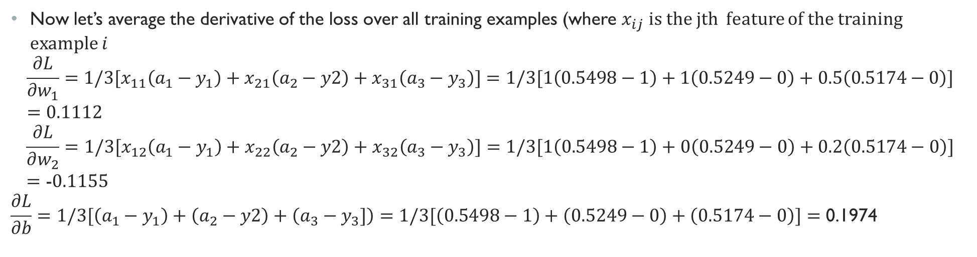
Gradient Descent Example: Computing the gradients (cont.)
Now let’s average the derivative of the loss over all training examples (where $x_{ij}$ is the jth feature of the training example $i$
$$\frac{∂L}{∂w_{1}}={1/3[x}_{11}\left(a_{1}−y_{1}\right)+x_{21}\left(a_{2}−y2\right)+x_{31}\left(a_{3}−y_{3}\right)]=1/3[1\left(0.5498−1\right)+1\left(0.5249−0\right)+0.5\left(0.5174−0\right)]=0.1112$$
$$\frac{∂L}{∂w_{2}}=1/3[x_{12}\left(a_{1}−y_{1}\right)+x_{22}\left(a_{2}−y2\right)+x_{32}\left(a_{3}−y_{3}\right)]=1/3[1\left(0.5498−1\right)+0\left(0.5249−0\right)+0.2\left(0.5174−0\right)]=\text{−}0.1155$$
$$\frac{∂L}{∂b}=1/3[\left(a_{1}−y_{1}\right)+\left(a_{2}−y2\right)+\left(a_{3}−y_{3}]\right)=1/3[\left(0.5498−1\right)+\left(0.5249−0\right)+\left(0.5174−0\right)]=\text{0.}\text{1974}$$

Slide 16
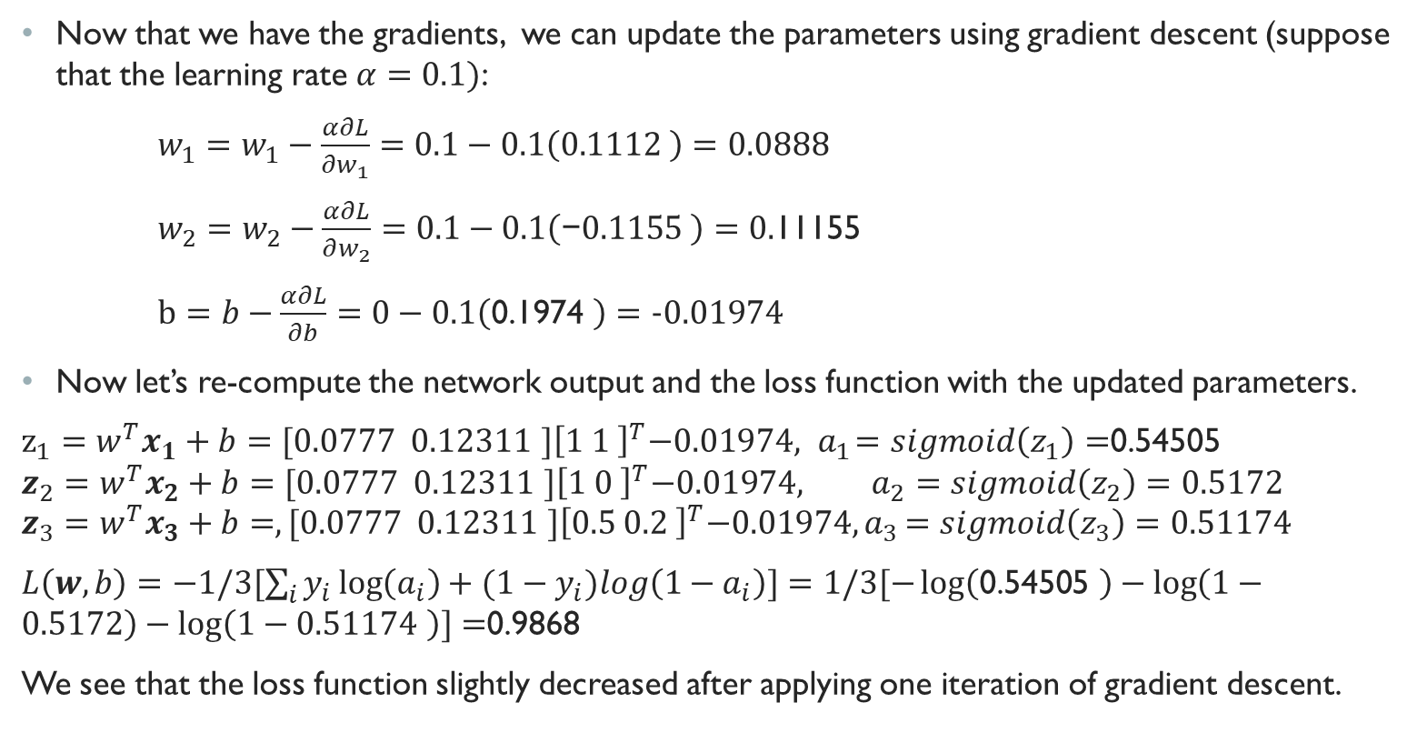
Gradient Descent Example: Updating The parameters
Now that we have the gradients, we can update the parameters using gradient descent (suppose that the learning rate $α=0.1)$:
$w_{1}=w_{1}−\frac{α∂L}{∂w_{1}}=0.1−0.1\left(0.1112 \right)=0.0888$
$w_{2}=w_{2}−\frac{α∂L}{∂w_{2}}=0.1−0.1\left(\text{−}0.1155 \right)=0.$11155
$b=b−\frac{α∂L}{∂b}=0−0.1\left(\text{0.1974} \right)=−0.01974$
Now let’s re-compute the network output and the loss function with the updated parameters.
$z_{1}=w^{T}x_{1}+b={[0.0777 0.12311 ]\left[1 1 \right]}^{T}−0.01974, { a}_{1}=sigmoid\left(z_{1}\right)=$0.54505
$$z_{2}=w^{T}x_{2}+b={[0.0777 0.12311 ]\left[1 0 \right]}^{T}−0.01974, a_{2}=sigmoid\left(z_{2}\right)=0.5172$$
$$z_{3}=w^{T}x_{3}+b=,{[0.0777 0.12311 ]\left[0.5 0.2 \right]}^{T}−0.01974{, a}_{3}=sigmoid\left(z_{3}\right)=0.51174$$
$L\left(w,b\right)=−1/3[\sum_{i}{y_{i}\log\left(a_{i}\right)+{(1−y}_{i})log\left(1−a_{i}\right)]}=1/3[−\log\left(\text{0.54505 }\right)−\log\left(1−0.5172\right)−\log\left(1−0.51174 \right)]=$0.9868
We see that the loss function slightly decreased after applying one iteration of gradient descent.

Slide 17
Gradient Descent Example: Monitoring loss
I implemented this example in python and shared it on google Colab
You can directly run the code on Google and do not need to install anything on your local machine
Google colab is basically jupyter notebook running on google cloud. It also provides free GPU and TPU (with some restrictions) to run your deep learning models on google cloud.
Please see this quick video tutorial to familiarize yourself with google Colab. Then follow this link to open and run the example we discussed in this lecture

